Slide 1
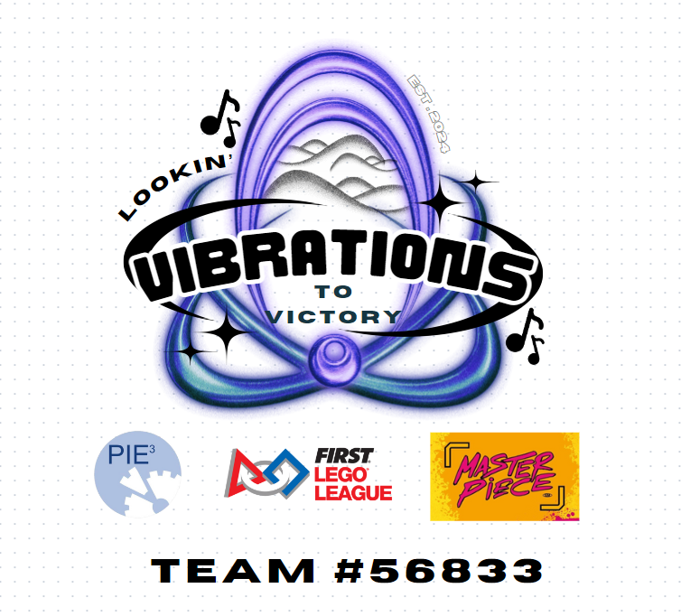
CYMATICS
Innovation Project
CYMATICS
CYMATICS

Slide 2
CYMATICS
Innovation Project
CYMATICS
CYMATICS

Slide 3

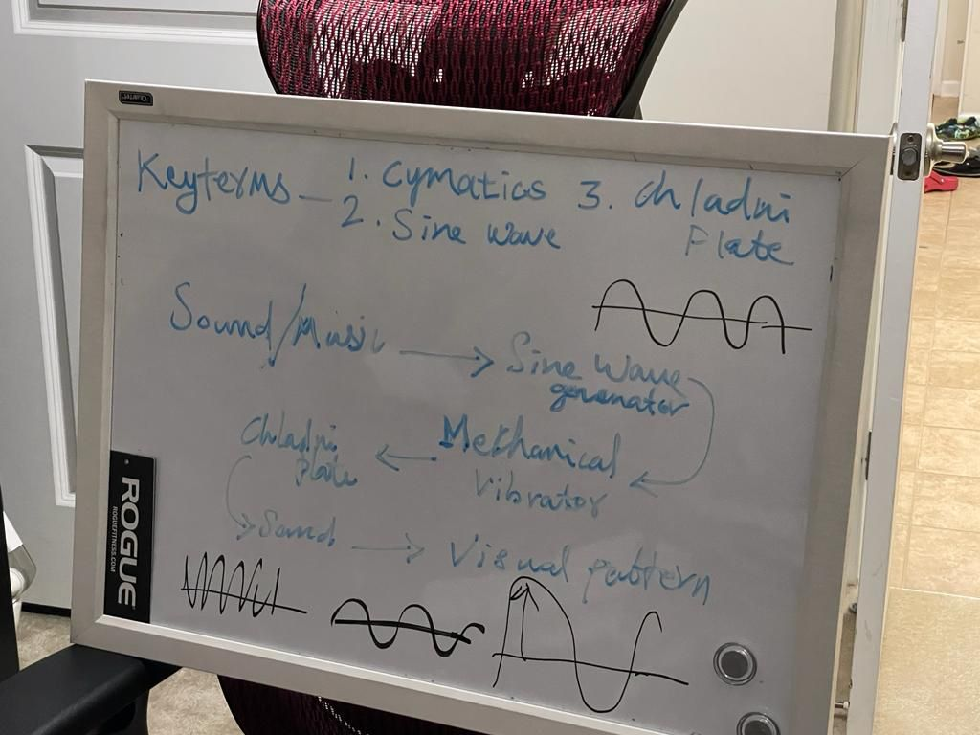
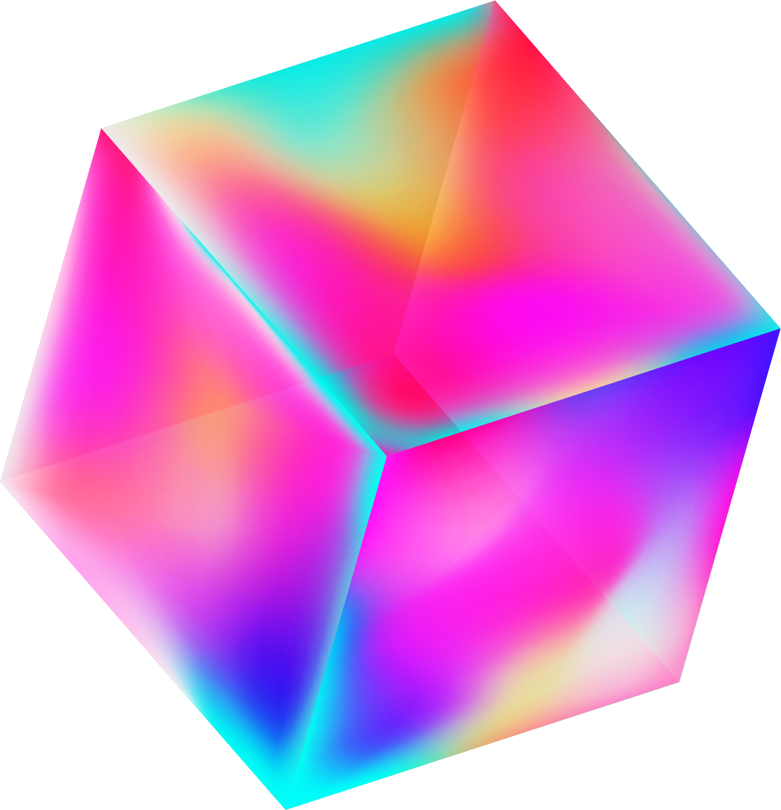
Brainstorming
All in one pen
Creative block
Recycle for art supplies
AR/VR for surgeries and medical procedures
Anti-Gravity art materials
Accurate landing procedures on the moon
Machine art teacher for disabled
Visual therapy for pain and dementia
Pulse-activating music
Levitating golf balls

Slide 4


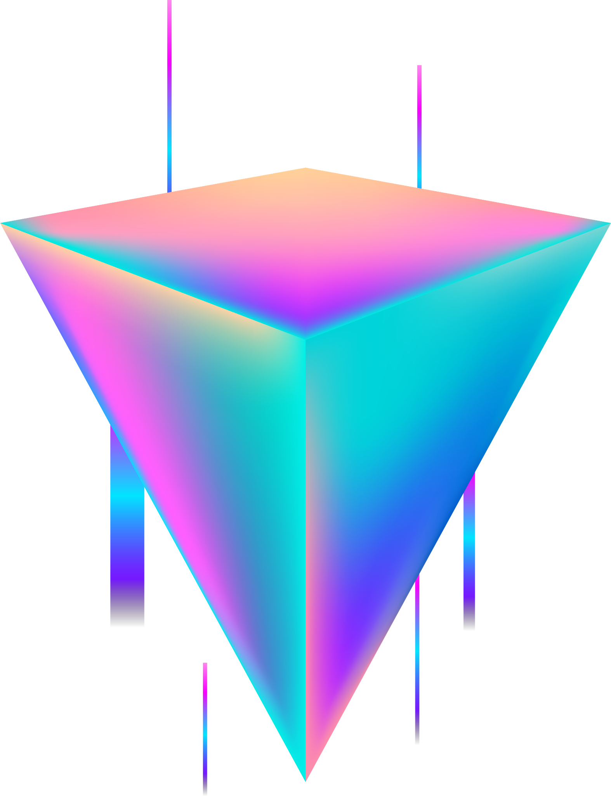
Anxiety and Stress are common issue throughout the world among the children. An often overlooked fact of Stress is that it suppresses creative expression. Creativity is important for relaxation, problem solving, and even fosters an open-minded perspective as a society. The issue is that therapy, the number one way to deal with stress, only focuses on audible satisfaction and lacks this creative energy. What if there is a way to combine creative expression with therapy to bridge this artistic block and possibly allow for more motivation?

Slide 5
SOLUTION
Art, Music and Cymatic Therapy are the key factors into making the Chladni Plate one of the main instruments for Therapy. The Chladni Plate is a thick metal sheet with sand on top. It generates pictures and patterns using sand and vibrations just from 400 hz. For the demo, we used a circular plate and a square shaped plate and found very different results.
Fidgeting with these different notes, frequencies, and patterns can be very calming and relaxing.
If this project can be adopted at a county level we could create cool instruments for students to play with, which could help them relieve their stress and anxiety.

Slide 6
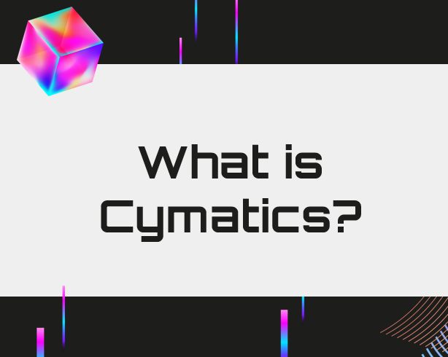
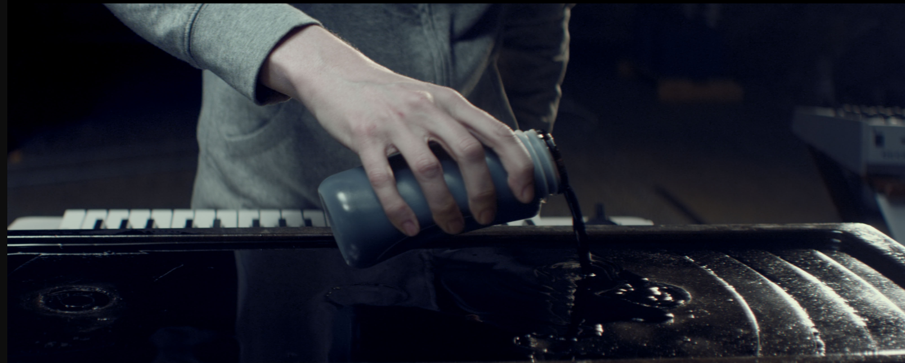
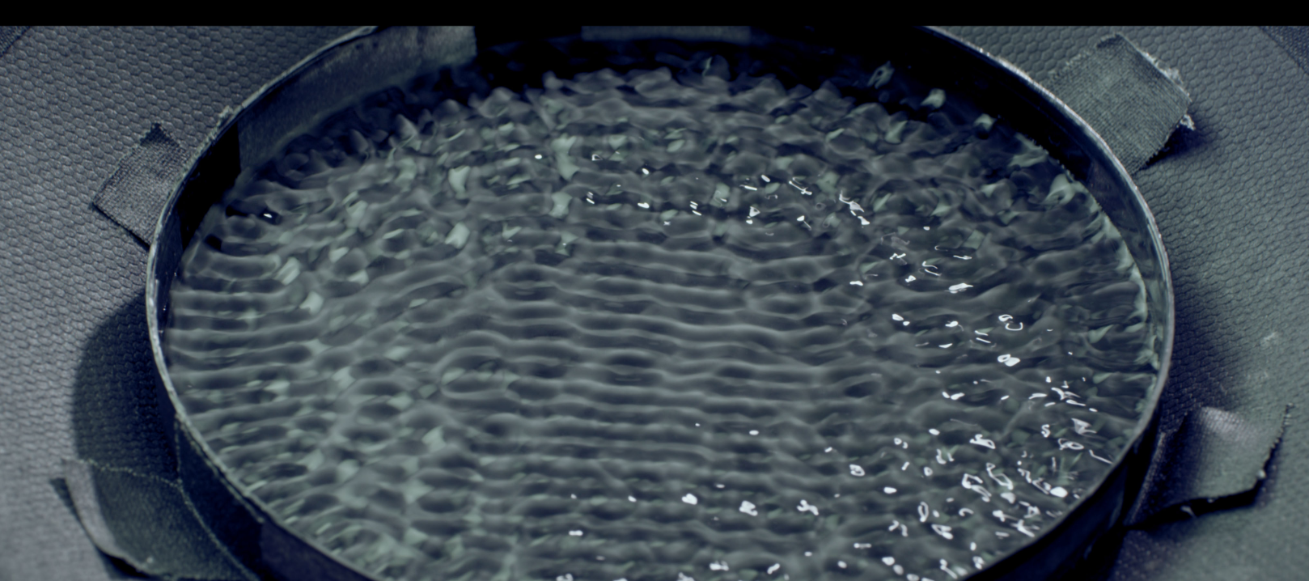
According to Physics, all objects have a frequency at which they vibrate. Cymatics provides us with a visual representation of the impact of sound and vibration on various substances and unveils the hidden connection between sound and matter

Slide 7

Application
Cymatics highlights the interplay between sound, vibration, and matter, unveiling the underlying harmonies present in the universe. The therapeutic properties of sound and vibration can be used for sound healing therapies, where specific frequencies are used to promote relaxation, balance, and healing. The concept

Slide 8
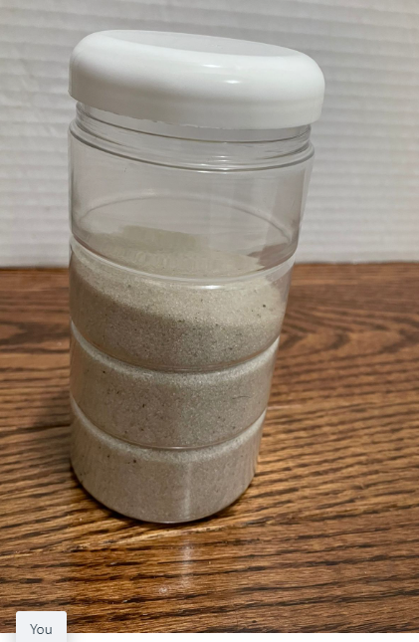
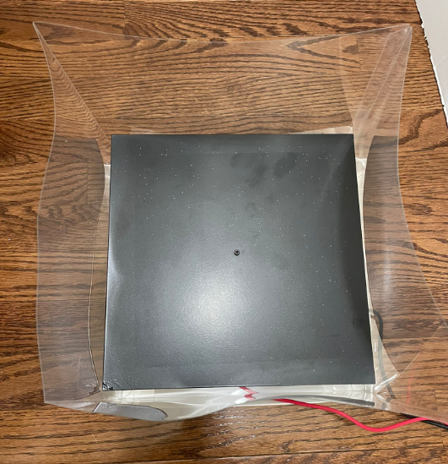
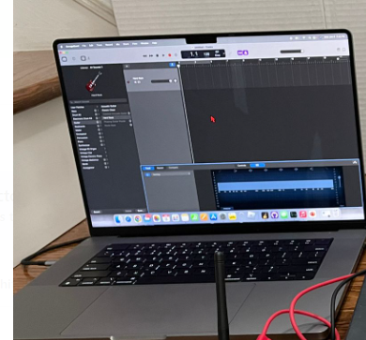
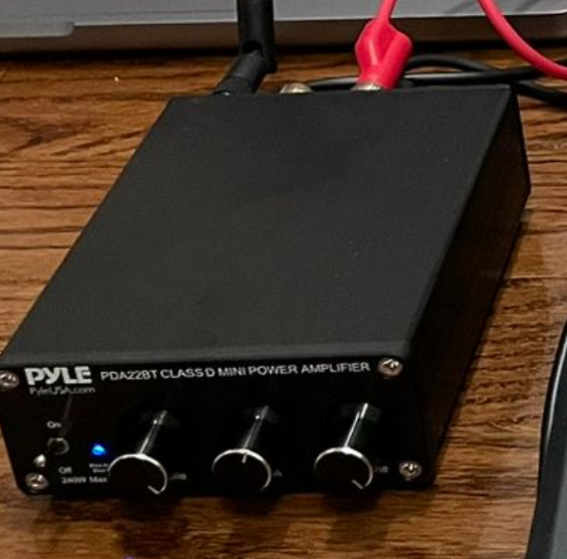
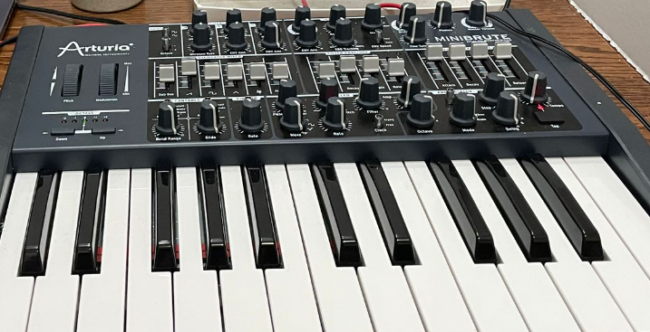
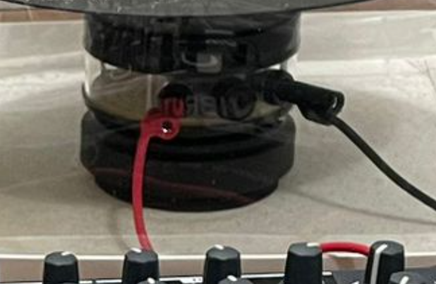
Prototype Hardware Requirements
Explain
Chladni Plate
Sand
Laptop(Garage Band App)
Amplifier
Mini Piano
Vibrator

Slide 9




Prototype Model Diagram
Cymatic Pattern
Mini Piano
Chladni Plate
Vibrator
Amplifier
Laptop/Phone
Tray to hold the Chladni plate and Sand

Slide 10
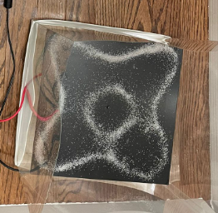
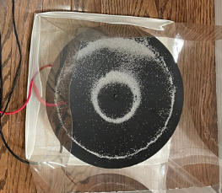
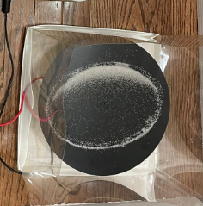
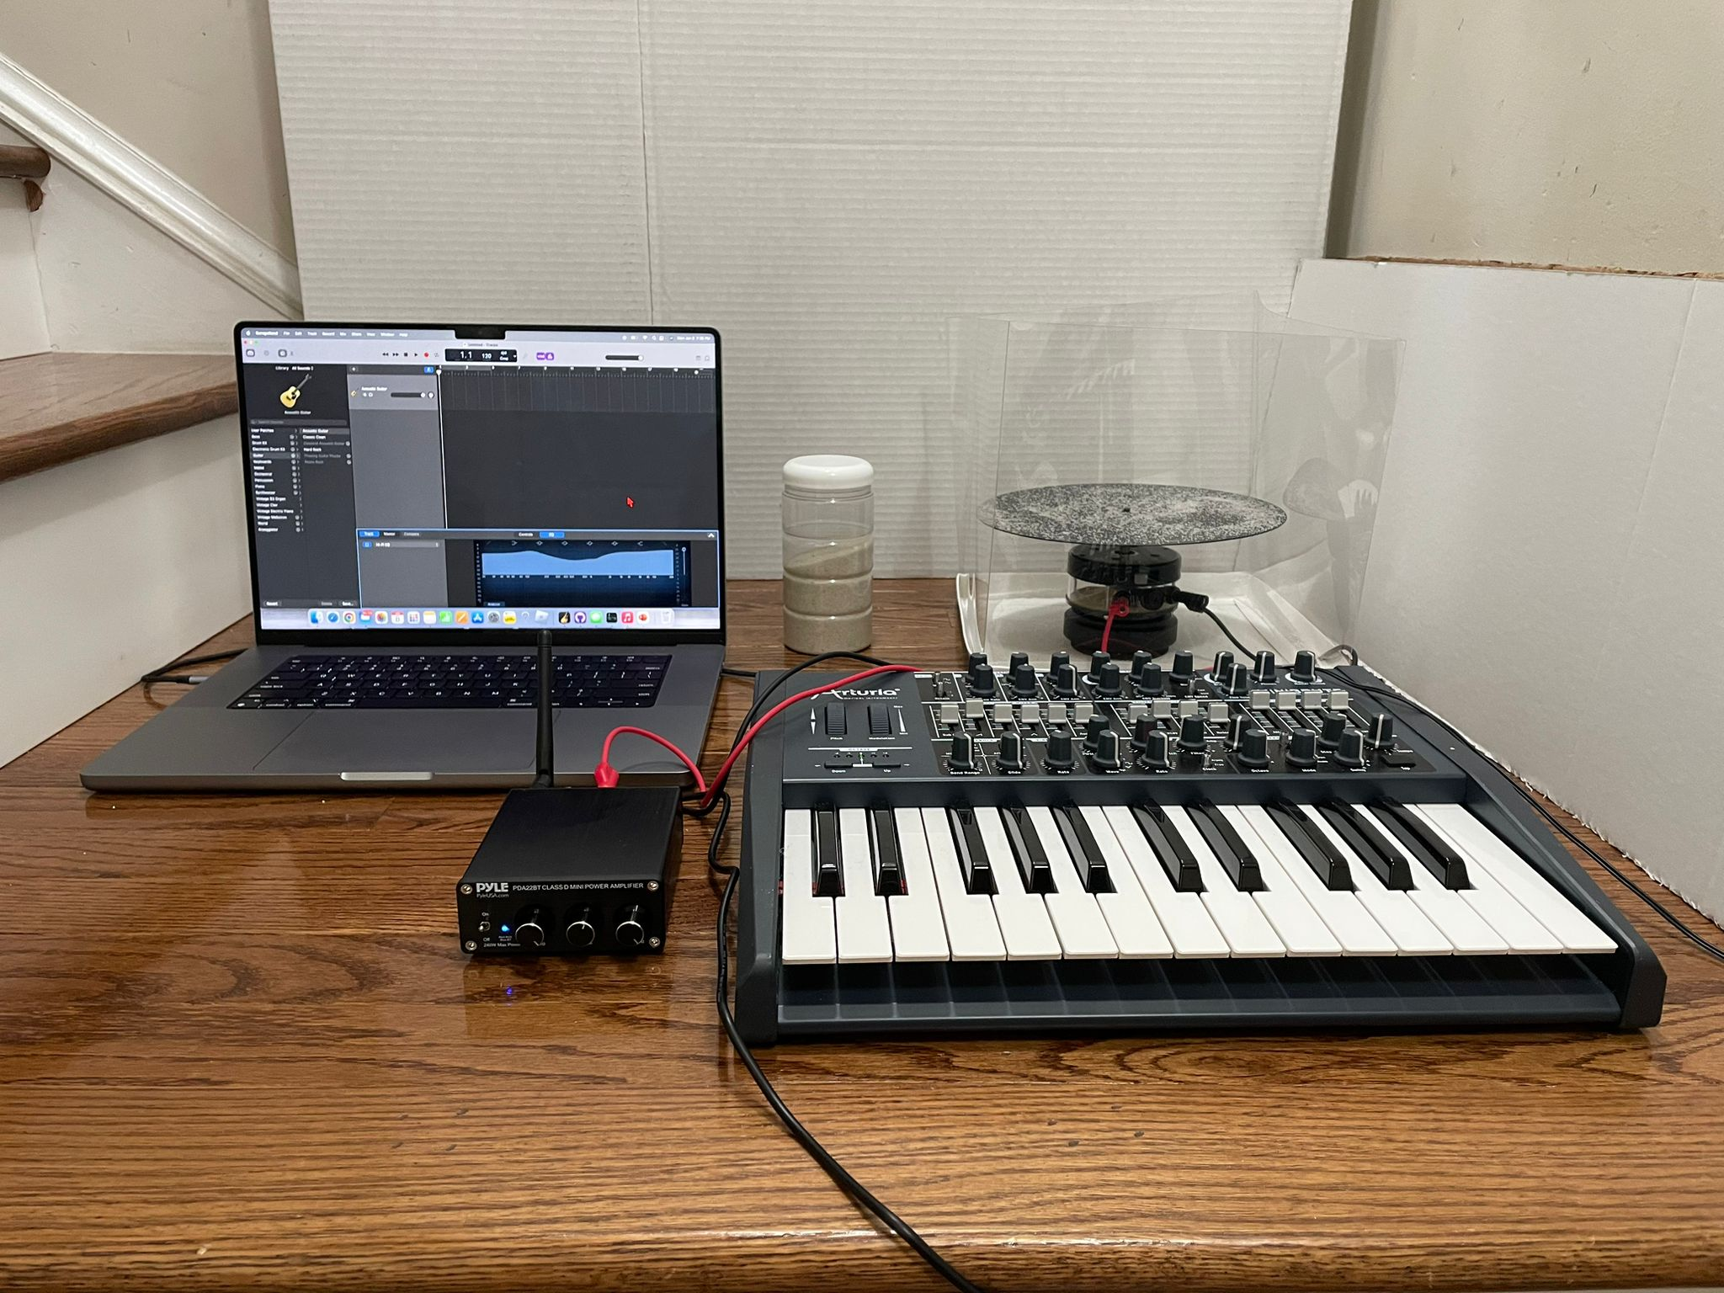
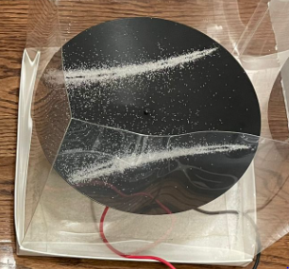

Slide 11
Advantages

Slide 12
Costs and Limitations

Slide 13
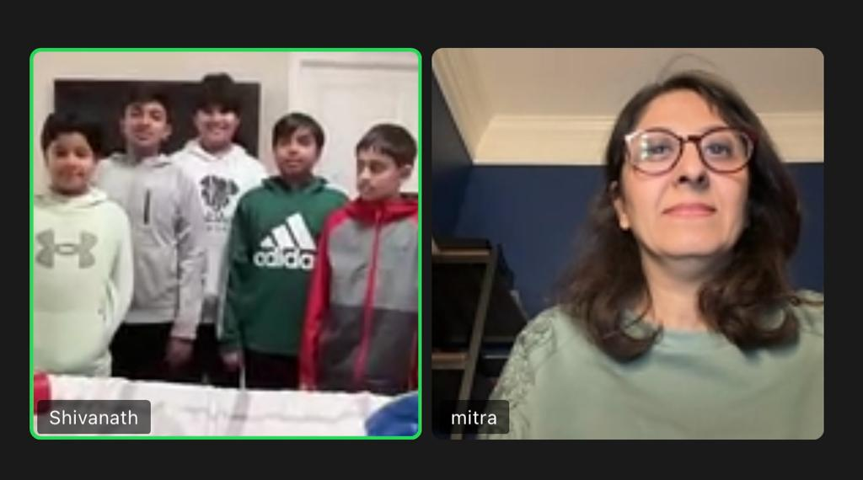
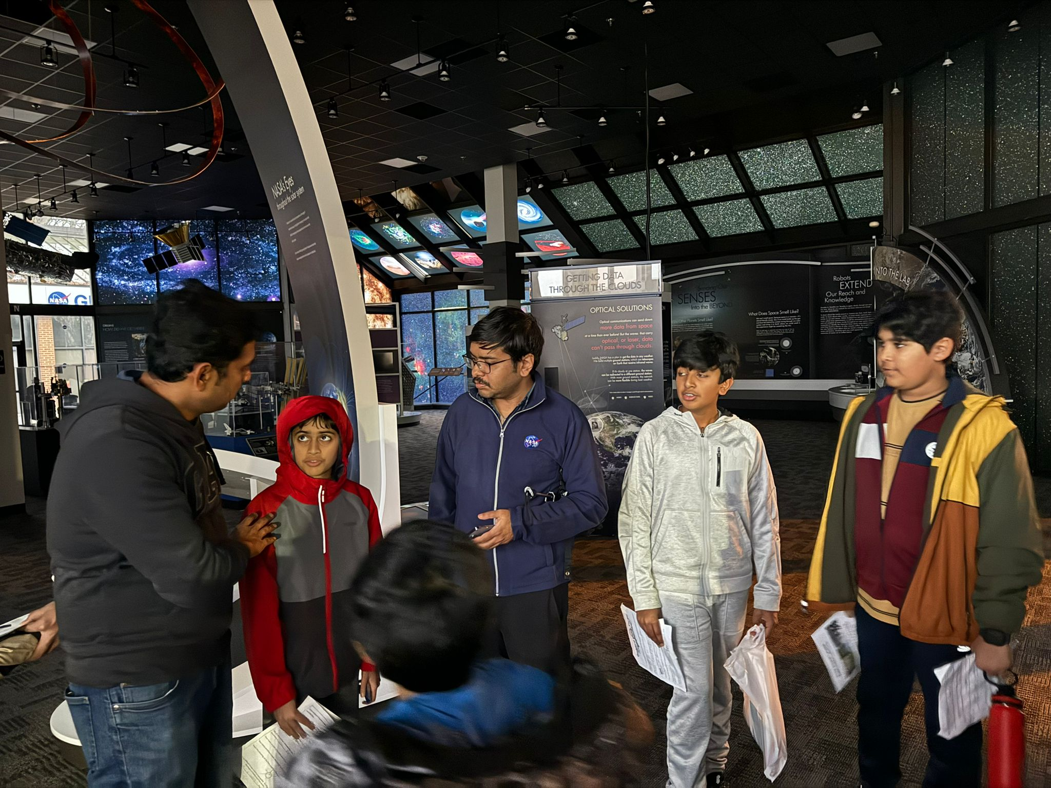
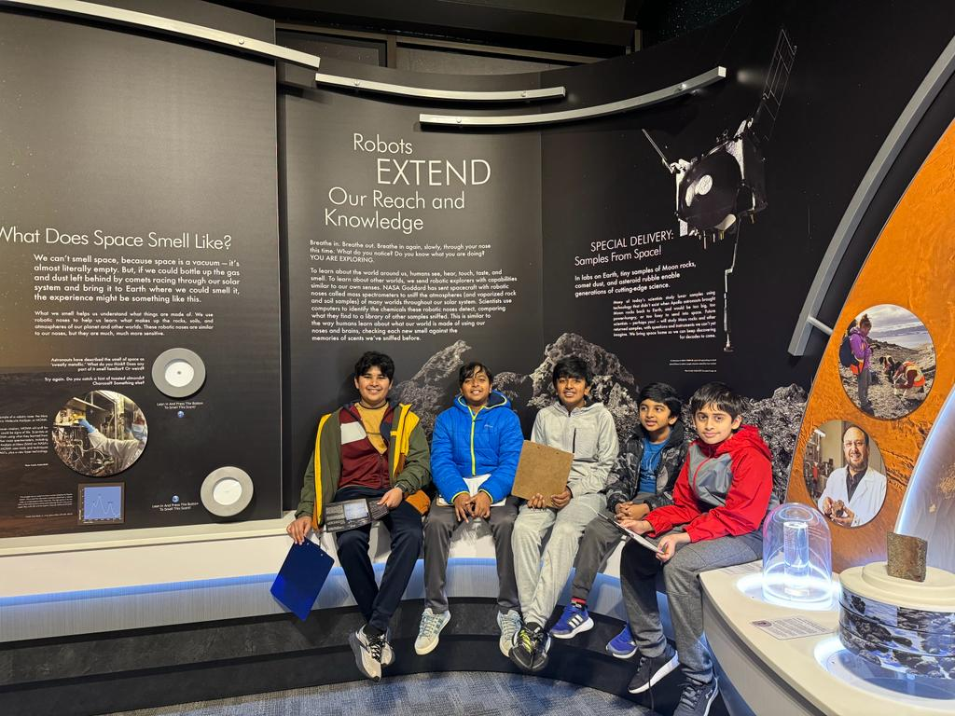
Outreach

Slide 14
Sources/Citations
https://nigelstanford.com/Cymatics/#:~:text='Cymatics'%20is%20the%20science%20of,the%20science%20behind%20the%20visuals.

Slide 15
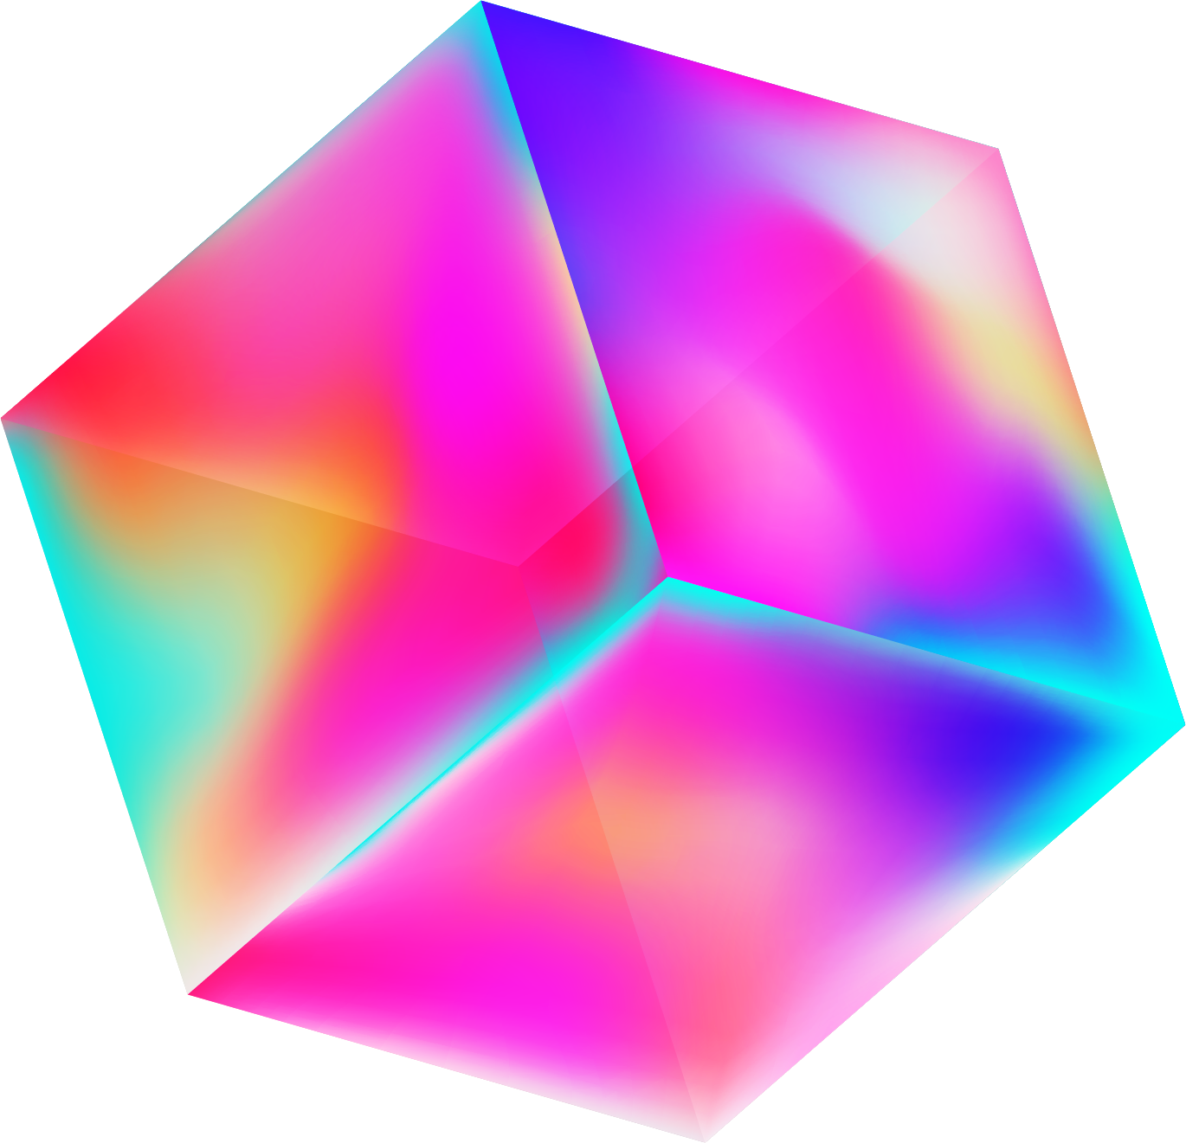
Our ideas
Ideas | Budget | When | Team | Comments | Rating
Idea 1 | Budget 1 | Insert the date | Team 1 | Comment 1 | 4/5
Idea 2 | Budget 2 | Insert the date | Team 2 | Comment 2 | 1/5
Idea 3 | Budget 3 | Insert the date | Team 3 | Comment 3 | 3/5
Idea 4 | Budget 4 | Insert the date | Team 4 | Comment 4 | 2/5
Idea 5 | Budget 5 | Insert the date | Team 5 | Comment 5 | 5/5
Idea 6 | Budget 6 | Insert the date | Team 6 | Comment 6 | 4/5

Slide 16
